Slide 1
Secure Medical Data Sharing and Storage with Identity-Based Encryption

Slide 2
Team Member
Souhardya Halder (234101065)

Slide 3
Introduction
Identity-based encryption (IBE) is a type of public-key cryptography in which a user’s public key is derived from their unique identity, such as an email address , simplifying the encryption process and making secure communication more accessible and efficient.
A trusted third-party server, called the Private Key Generator (PKG), generates the corresponding private keys.

Slide 4
Why IBE ?
IBE uses user Identity as public keys , and using that Identity PKG (Private Key Generator ) generates a Secreat Key for each user , using which one user can decrypt ciphertext data
This eliminates the need for distributing public keys ahead of exchanging encrypted data. However, the PKG must be highly trusted, as it is capable of generating any user’s private key and may therefore decrypt messages without authorization.

Slide 5
An IBE Scheme
This project focuses on adapting the BonehFranklin IBE scheme to enhance secure medical data management
An IBE scheme is defined in terms of four algorithms Setup, Key Derivation, Encryption and Decryption

Slide 6
Setup Phase
The ”Setup” phase is the initial step in an Identity Based Encryption system, responsible for configuring the foundational parameters and creating the necessary components to enable secure communication .During this phase A trusted entity, often referred to as the Private Key Generator (PKG), generates essential cryptographic parameters, including group structures and security parameters. These parameters lay the foundation for secure key derivation and encryption.
Parameter Gerneration : q , G ,Gt ,g ,e ,x .
q = big prime number ; G , Gt = two multiplicative cyclic group ;
g = generator ; e = bilinear pairing map ; x = master secret key

Slide 7
Key Generation
This phase is the process of deriving a user’s private key based on their identity. The user’s identity, which could be an email address or any unique identifier, is mapped to an appropriate element within the established group structure
Secret Key : SKi is generated using (Hash1(Identity))^x

Slide 8
Encryption
A sender encrypts a message to ensure that only the intended recipient can access its contents .The sender identifies the recipient by their identity, which may be an email address or another identifier, to determine which user’s public key to use for encryption.
We calculate C1=g^r , where r is random r over Zp.
We calculate C2= m xor Hash2(bilinear pair (Hash1(Identity) , Q)^r)

Slide 9
Decryption
The Decryption phase is executed by the recipient to recover the original message from the ciphertext.The recipient, using their identity and the master secret key, derives their unique private key. This private key corresponds to the public key used for encryption.
C2 xor Hash2(bilinear Pair(Ski , C1))
m xor Hash2(bilinear pair (Hash1(Identity) , Q)^r) xor Hash2(bilinear Pair(Ski , C1))

Slide 10
Decryption (contd.)
m xor Hash2(bilinear pair (Hash1(Identity) , g^x)^r) xor Hash2(bilinear Pair((Hash1(Identity))^x , g^r))
m xor Hash2(bilinear pair (Hash1(Identity) , g)^xr) xor xor Hash2(bilinear Pair((Hash1(Identity)) , g)^xr)
m , the original message is decrypted this way.

Slide 11
Technology and Library Used
Tecnnology Stack : Spring Boot a popular Java based framework.
Database : Mysql server is used for storing encrypted data.
Library : jpbc (java pairing based cryptography) is used to perform IBE algorithm

Slide 12
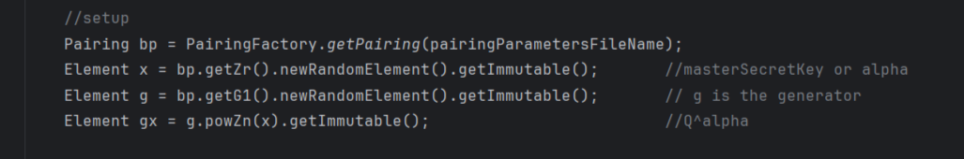
Results

Slide 13
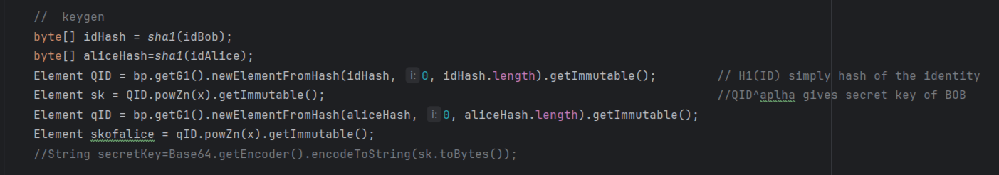
Results (Contd.)

Slide 14
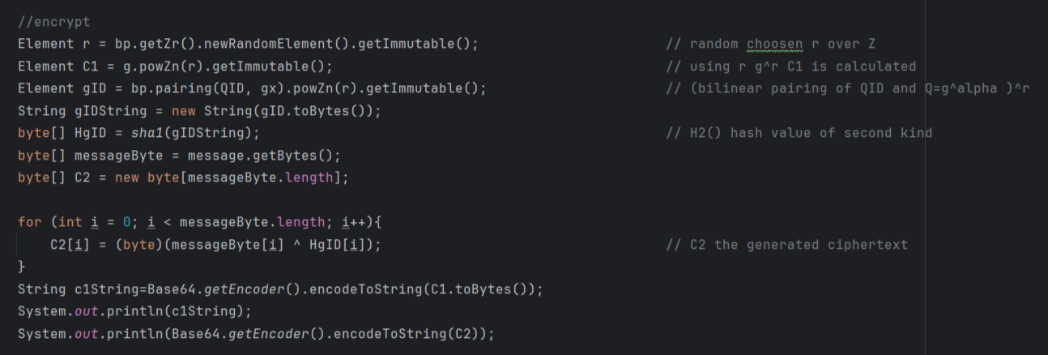
Results (Contd.)

Slide 15
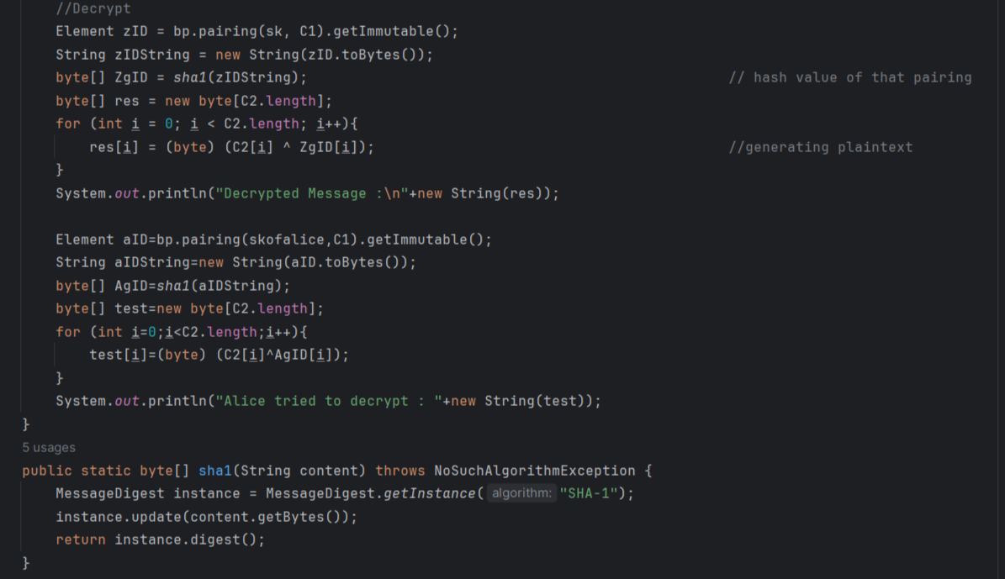
Results (Contd.)

Slide 16
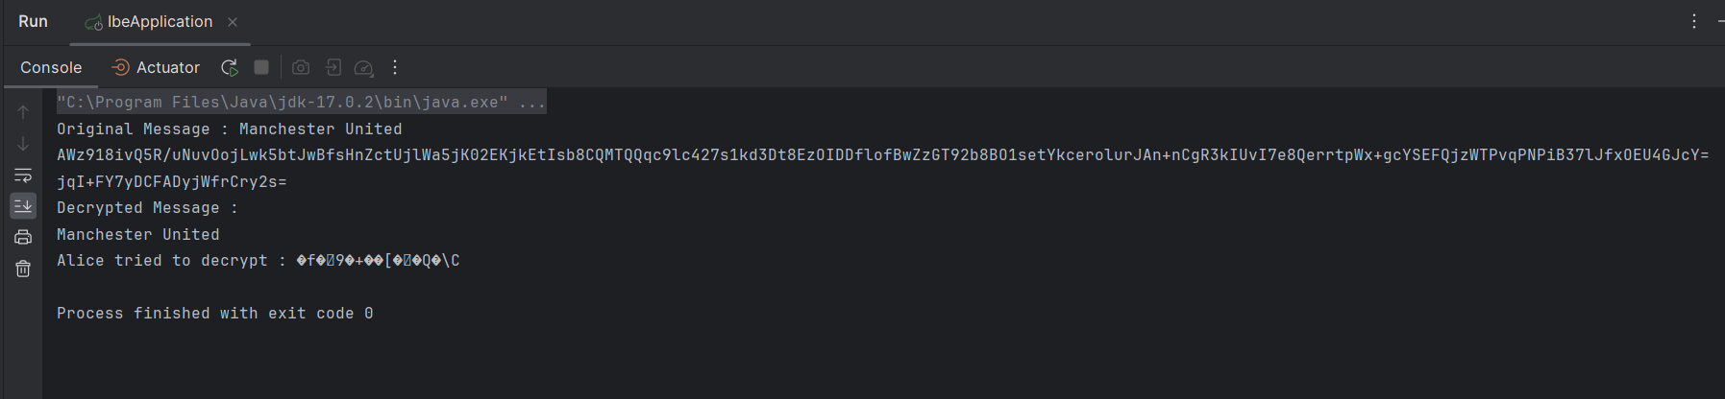
Results (Contd.)

Slide 17
Application Framework
The implementation of our secure medical data sharing and storage system is centered around a user-friendly application framework.
User Authentication: The first step in our system is user authentication. Users, including end-users and hospital authorities, are required to log in using their unique email addresses.
Data Upload: Once authenticated, users can upload medical data reports to the system. This is a straightforward process that involves specifying the recipient’s email address.

Slide 18
Application Framework (Contd.)
Data Encryption : Our system leverages Identity-Based Encryption (IBE) to enable secure and efficient data sharing using Boneh-Franklin IBE scheme. Before the data is stored in our system, it is encrypted using the recipient’s email-based public key. This encryption ensures that the data remains confidential during storage and transit.
Data Decryption: On the recipient’s side, the decryption process is initiated by generating their private key based on their identity (email address). This private key, combined with the recipient’s email-based identity, allows them to decrypt the data and access the medical reports securely.

Slide 19
Conclusion
This project introduced an end-to-end solution that combines user authentication, cryptographic key management, and efficient data sharing, all within a user-friendly application framework. The core premise of our project is the use of identity-based email addresses as the basis for cryptographic key generation and secure data exchange.

Slide 20
THANK YOU

